Slide 1

LEVEL 3 QUALIFICATIONS IN GREATER LINCOLNSHIRE – AN EVIDENCE BASE
JULY 2024

Slide 2

ACKNOWLEDGEMENTS AND DISCLAIMER
The SkillsReach team (Roy Harper and Adam Peacock) acknowledges the support and important contributions from stakeholders, including the Lincolnshire AEB Learning Partner Group members who supported through verifying or adding to our datasets; and by providing thoughtful insight into how Level 3 is progressing locally. A full list of stakeholders and references is available by request to roy.harper@skillsreach.co.uk
This document contains data made available under an Open License and accessed via the Department for Education and the Office for National Statistics. Data has also been obtained under Greater Lincolnshire LEP’s licence with Lightcast.
SkillsReach and its associates are not responsible for data verification nor data-cleaning, and data has been analysed as is, with any faults. As such, all data-driven conclusions in this report are based purely on the data available for public access at the time of writing. All data used in this document is either the most up-to-date available at the time of the data review, or the most relevant.
All maps have been produced using the open-source Geographic Information Systems software ‘QGIS,’ produced by the QGIS Development Team (2024) and made possible by the Geospatial Foundation Project.
The SkillsReach Team – March 2024

Slide 3

CONTENTS
SLIDE NUMBER
INTRODUCTION 4
SUMMARY
- What the Data Tells Us 5
OUR APPROACH 6
OUR SKILLS ECOSYSTEM MODEL 9
SKILLS INFRASTRUCTURE
- Level 3 Provision in Greater Lincolnshire 8
PEOPLE
- Level 3 Qualifications Amongst the Resident Population and Associated ‘Pathways’ 24
EMPLOYERS
- Demand for Level 3 Qualifications 46

Slide 4

4
INTRODUCTION
This report was commissioned by Lincolnshire County Council with the aim of developing and presenting an up-to-date evidence base for the Level 3 qualification landscape for adults across Greater Lincolnshire (the area made up of Lincolnshire, North East Lincolnshire, and North Lincolnshire). The report is structured through an application of our Local Skills Ecosystem approach, providing extensive innovative data analysis. In addition to an explanation of our method, approach and a short summary, this document is split into three sections as follows:
Skills Infrastructure – Level 3 provision across Greater Lincolnshire - with a focus on Greater Lincolnshire based providers, funding allocations and primary Level 3 pathways such as Advanced Apprenticeships.
People – Level 3 qualifications amongst the resident population and associated pathways – an analysis of Greater Lincolnshire learner demand for the main Level 3 provision, and changes in qualifications held and attainment at Level 3 over the last decade.
Employers – Demand for Level 3 qualifications – using primarily Lightcast data on vacancies this section provides a view of employer demand for Level 3 qualifications across Greater Lincolnshire past, present and into the future.

Slide 5
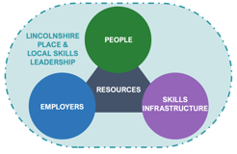
5
SUMMARY - WHAT THE DATA TELLS US
Nearly three quarters (74 per cent) of Greater Lincolnshire resident Level 3 learning aim enrolments were with Greater Lincolnshire-based providers. In terms of provision outside of Greater Lincolnshire, both the TEC Partnership and Inspire Education Group rank highly with enrolments by Greater Lincolnshire residents at campuses in Doncaster and Peterborough respectively.
Locally, there is an increasing market share of enrolments at Level 3 across both Education and Training and Apprenticeships held by independent providers though FE Colleges continue to make up the majority of enrolments.
Education and Training Level 3 enrolment numbers at Greater Lincolnshire-based providers has increased by around 2,000 between 2017/18 and 2022/23, whilst Level 3 Apprenticeship start numbers have been fairly consistent over the last six years.
SKILLS INFRASTRUCTURE
Local participation rates in FE and Skills continue to outperform the national rate though the gap in performance has closed over time. However, this masks the fact that both resident participation and achievement in Level 3 Education and Training in Greater Lincolnshire is below the national rate, and decreasing further, with the gap in performance widening over time.
74 per cent of local adult participation at Level 3 is via Apprenticeships which remain significantly more important than nationally where ‘Education and Training’ plays a more prominent part.
Level 3 Apprenticeship start numbers across many subject areas had increased post pandemic but 2022/23 sees many of them back to their pandemic lows. Only starts in ‘Health / Care’ and ‘Construction’ show any real signs of recovery and growth.
PEOPLE
A lower qualification profile in Greater Lincolnshire with workers less likely to have higher qualifications at Level 4 and above when compared nationally, and with higher proportions qualified at Level 3 and below.
A notably larger proportion of workers with Level 2 qualifications and below in North East Lincolnshire.
An increasing growth in vacancies stating a minimum Level 3 qualification in more recent years which is being driven by demand in North East Lincolnshire and North Lincolnshire.
Greater Lincolnshire will have approximately 47,000 Level 3 job opportunities that will need filling between now and 2035. 6,000 of these will be new jobs, with 41,000 connected to ‘replacement demand’.
EMPLOYERS

Slide 6
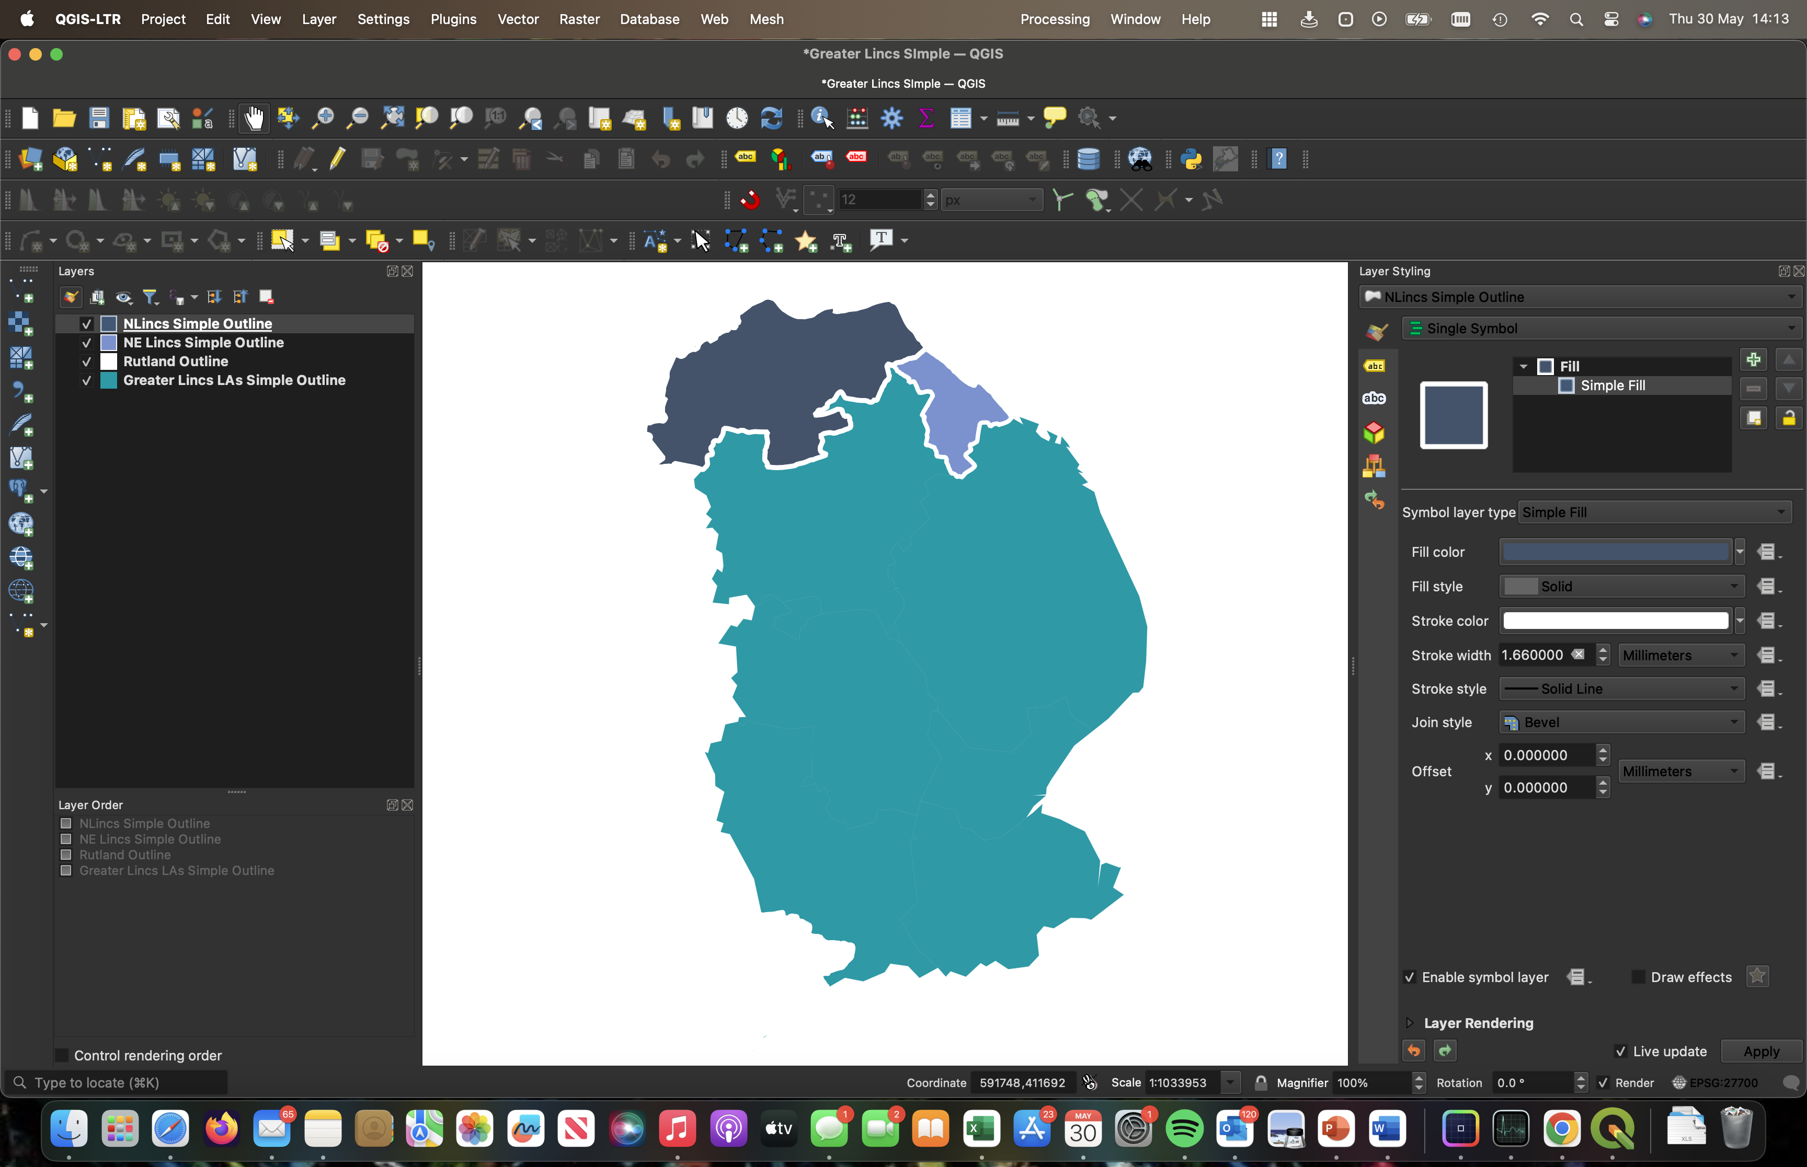
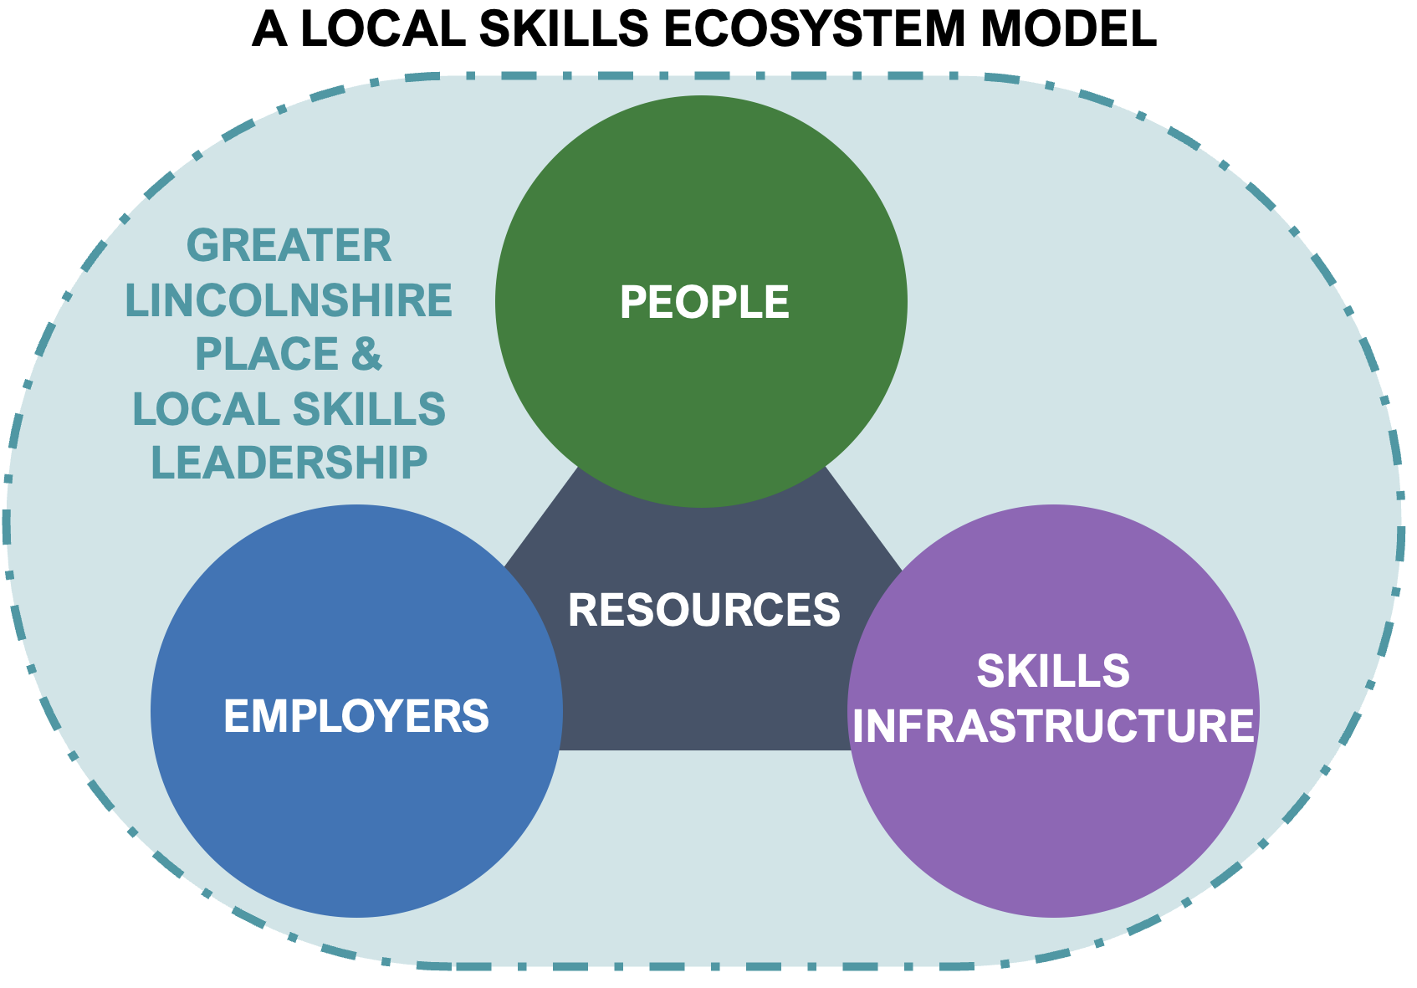
6
OUR APPROACH
OUR APPROACH
A Unitary Authority View of Greater Lincolnshire
Methodology
A Place-Based Skills Ecosystem
Verify – Challenge – Localise!
We ensure that our data and insight analysis is ‘stress-tested’ through skills conversations with local stakeholders, providing ample opportunity for challenge and balance with local ‘intelligence’.
The report is produced in the context of a local ‘Skills Ecosystem,’ reflecting the importance and balance between the three interdependent elements of People (supply), Employers (demand), and Skills Infrastructure (provision, providers, and other skills leaders).
Throughout this report, and where the data allows it and is relevant, analysis is provided at either a provider or upper tier authority area level.

Slide 7
7
OUR SKILLS ECOSYSTEM MODEL
A LOCAL SKILLS ECOSYSTEM MODEL
PLACE: The critical driver focusing upon local need, initiative, and action adding value to national skills policy.
PEOPLE: Our ‘learning communities’ including Greater Lincolnshire residents, workers, self-employed, unemployed, and economically inactive.
GREATER LINCOLNSHIREPLACE & LOCAL SKILLS LEADERSHIP
PEOPLE
EMPLOYERS: Local/national employers and businesses that generate demand for skills in workforces and supply chains.
SKILLS INFRASTRUCTURE: The combined assets and reach of our (primarily local) skills and education providers, physical learning resources, allied stakeholders, e.g., Careers Advice, etc.
RESOURCES
SKILLS
INFRASTRUCTURE
EMPLOYERS
RESOURCES: These sit at the model’s centre, traversing the three elements and reflecting that all three are potential skills investors.

Slide 8

8
SKILLS INFRASTRUCTURE
LEVEL 3 PROVISION IN GREATER LINCOLNSHIRE

Slide 9

9
SKILLS INFRASTRUCTURE – LEVEL 3 PROVISION IN GREATER LINCOLNSHIRE
Introduction:
This section concentrates on Level 3 resident enrolments and courses delivered by Greater Lincolnshire based providers, mainly to Greater Lincolnshire adult residents aged 19 plus. In consultation with Lincolnshire County Council, we set out below a list of Greater Lincolnshire based providers identifiable on Department for Education datasets which are considered collectively as part of this analysis:
Bishop Burton College (Riseholme)
Bishop Grosseteste University
Boston College
Community Learning in Partnership (CLIP)
DN Colleges Group
East Lindsey IT Centre (First College)
Franklin College
Grantham College
Inspire Education Group
John Leggott Sixth Form College
LAGAT
Lincoln College
Lincolnshire Community Health Services NHS Trust
Lincolnshire County Council
North East Lincolnshire Council
North Lincolnshire Council
Riverside Training
Steadfast Training
TEC Partnership
University of Lincoln
It is recognised that there are other learning providers operating in Greater Lincolnshire that stand outside of the above list, but which also provide an important contribution to adult learning locally – perhaps through ‘supply-chain’ / subcontractor partnerships with local or national ‘Primes’; or through a focus upon local community needs outside of ‘mainstream’ funded delivery.

Slide 10
10
SKILLS INFRASTRUCTURE – LEVEL 3 PROVISION IN GREATER LINCOLNSHIRE
What the data tells us:
Nearly three quarters (74 per cent) of Greater Lincolnshire resident Level 3 learning aim enrolments were with Greater Lincolnshire-based providers, including 73 per cent of Advanced Apprenticeships and 76 per cent of Education and Training enrolments. Of the remaining quarter that are delivered outside of Greater Lincolnshire, both the TEC Partnership and Inspire Education Group rank highly with enrolments by Greater Lincolnshire residents at campuses in Doncaster and Peterborough respectively.
Locally, there is an increasing market share of enrolments at Level 3 across both Education and Training and Apprenticeships held by independent providers though FE Colleges continue to make up the majority of enrolments.
Education and Training Level 3 enrolment numbers at Greater Lincolnshire-based providers has increased by around 2,000 between 2017/18 and 2022/23, whilst Level 3 Apprenticeship start numbers have been fairly consistent over the last six years. DN Colleges Group, Inspire Education Group and TEC Partnership have all increased their Education and Training Level 3 enrolment numbers significantly over this period whilst Boston, Grantham and Lincoln colleges have seen falls in enrolment numbers.
At a sector subject area level, this increase in enrolments has been driven mainly by increases in enrolments in ‘Health, Public Services and Care’. There have also been modest increases in enrolments in ‘Engineering and Manufacturing Technologies’, ’Science and Mathematics’, and ‘Arts, Media and Publishing’.

Slide 11
11
PROVISION TO GREATER LINCOLNSHIRE RESIDENTS BY GREATER LINCOLNSHIRE BASED PROVIDERS
Of the 4,612 learning aim enrolments at Level 3 with Greater Lincolnshire based providers in 2022/23, half (50 per cent) of these were enrolments by Greater Lincolnshire residents.
Of Greater Lincolnshire based providers delivering more than ten Level 3 aim enrolments, Franklin College is the most “Greater Lincolnshire focused” provider with 100 per cent of its Level 3 aim enrolments being with Greater Lincolnshire residents. This is closely followed by Boston College (98 per cent of aim enrolments) and East Lindsey IT Centre (97 per cent of aim enrolments).
In terms of total aim enrolments delivered to Greater Lincolnshire residents, then the TEC Partnership had the most at 1,614, over a third (35 per cent) of the total Level 3 aim enrolments by Greater Lincolnshire residents in 2022/23. This however was just over half of the TEC Partnership’s total Level 3 aim enrolments demonstrating its level of delivery outside of the Greater Lincolnshire area.
Source: Department for Education
Further Education and Skills Level 3 aim enrolments by Greater Lincolnshire-based providers, 2022/23

Slide 12
12
LEVEL 3 FURTHER EDUCATION & SKILLS DELIVERY TO GREATER LINCOLNSHIRE RESIDENTS AGED 19 PLUS
Just under three quarters (74 per cent) of Further Education and Skills Level 3 aim enrolments by Greater Lincolnshire residents are with Greater Lincolnshire based providers. In terms of other areas, Rugby appears on this list due to the delivery of aims via Her Majesty’s Prison & Probation Service and the Ministry of Justice. It is not clear whether these aim enrolments are by staff or inmates. Peterborough appears third in the list mainly through the presence of Inspire Education Group (98 aim enrolments) which operates campuses both inside Greater Lincolnshire at Stamford, and outside in Peterborough though this campus is accessible to Greater Lincolnshire residents. The remaining aim enrolments are with a further 59 Peterborough based providers.
Notes:
- Our analysis suggests that an overall average of approximately four aim enrolments are taken up by one Learner. (This varies considerably per intervention).
- Providers identified as being ‘outside of England and unknown’ are primarily due to lack of data and insufficient reporting.
Source: Department for Education
Level 3 Greater Lincolnshire resident Further Education and Skills aim enrolments across Greater Lincolnshire-based and external providers, 2022/23
Top 10 areas (on number of Further Education and Skills aim enrolments) where external providers (delivering to Greater Lincolnshire residents) are based, 2022/23
2,693 (26%)
7,588 (74%)

Slide 13
13
LEVEL 3 APPRENTICESHIP DELIVERY TO GREATER LINCOLNSHIRE RESIDENTS AGED 19 PLUS
Advanced (Level 3) Greater Lincolnshire resident Apprenticeship aim enrolments by Greater Lincolnshire-based and external providers, 2022/23
Top 10 areas (on number of Advanced Apprenticeship aim enrolments) where external providers (delivering to Greater Lincolnshire residents) are based, 2022/23
Nearly three quarters (73 per cent) of Advanced (Level 3) Apprenticeship aim enrolments by Greater Lincolnshire residents are with Greater Lincolnshire based providers. In terms of external areas and providers, Rugby appears due to the delivery of aims via Her Majesty’s Prison & Probation Service (HMPPS) and the Ministry of Justice. It is not clear, however, whether these aim enrolments are by staff or inmates. Peterborough appears second in the list mainly through the presence of Inspire Education Group (69 aim enrolments) although a further 58 external providers are delivering Advanced Apprenticeship aim enrolments for Greater Lincolnshire residents. The main provider delivering in Newark and Sherwood is Lincoln College (at its Newark campus?) with 32 Advanced Apprenticeship aim enrolments; with a further 31 external providers delivering aims to Greater Lincolnshire residents.
Notes:
Our analysis suggests that an overall average of approximately four aim enrolments are taken up by one learner. (This can vary considerably per intervention).
Source: Department for Education
1,930 (27%)
5,212 (73%)

Slide 14
14
ADVANCED (LEVEL 3) APPRENTICESHIPS (ALL AGES) BY GREATER LINCOLNSHIRE-BASED PROVIDER
Advanced (Level 3) Apprenticeship starts (all ages) by Greater Lincolnshire-based provider
Source: Department for Education
Level 3 Apprentice start numbers have been steady at c4,000 over a 6-year period. There are no obvious trends in starts for most providers, particularly those with the largest start numbers i.e., DN Colleges Group, Lincoln College, and the TEC Partnership. Only the Inspire Education Group has seen Apprenticeship starts increase with a more than doubling of numbers since 2019/20.
Notes:
- This analysis focuses upon Greater Lincolnshire-based providers likely to have a substantial element of their Apprentice cohort resident in Greater Lincolnshire, and therefore does not include some providers likely to have a significant proportion of residents from other areas (Steadfast Training being the exception). It also does not include most large local or national levy-paying employers with Greater Lincolnshire resident Apprentices e.g., large supermarket chains.

Slide 15
15
PROVIDER MARKET SHARE OF LEVEL 3 (ADVANCED) APPRENTICESHIP STARTS OVER TIME
Advanced (Level 3) Apprenticeship starts (all ages) by type of Greater Lincolnshire-based provider
Greater Lincolnshire based FE Colleges have seen their share of Advanced (Level 3) Apprenticeships fall over time, from 70 per cent in 2017/18 to 65 per cent in 2022/23. Over the same period, Greater Lincolnshire based independent providers have seen their share increase from 24 per cent to 29 per cent. Employer-led Apprenticeship starts have fallen from 3 per cent 1 per cent though there is no clear trend over this period (plus we note that there have been no Level 3 Apprenticeship starts at North East Lincolnshire Council and North Lincolnshire Council).
Notes:
- FE Colleges: Bishop Burton College, Boston College, DN Colleges Group, Franklin College, Grantham College, Lincoln College, TEC Partnership
- HE Institutions: Bishop Grosseteste University, University of Lincoln
- Employer-led: Lincolnshire Community Health Services NHS Trust, Lincolnshire County Council
- Independent: East Lindsey IT Centre (First College), Inspire Education Group, LAGAT, Riverside Training (Spalding), Steadfast Training
Source: Department for Education

Slide 16
16
ADVANCED (LEVEL 3) APPRENTICESHIP STARTS (ALL AGES) IN GREATER LINCOLNSHIRE-BASED PROVIDERS BY SSA
Advanced (Level 3) apprenticeship starts (all ages) in Greater Lincolnshire-based providers by Sector Subject Area (SSA)
The sector subject areas of ‘Engineering and Manufacturing Technologies’ and ‘Construction, Planning and the Built Environment’ are the only two that show clear growth in starts by Greater Lincolnshire-based providers over the last six years. The two other dominant sector subject areas of ‘Business, Administration and Law’ and ‘Health, Public Services and Care’ are yet to sustain recovery from their pandemic lows.
Questions:
- Is there a connection between apprenticeship investment by ‘subject’ and Greater Lincolnshire’s game-changing growth sectors?
Notes:
- The definition of ‘Greater Lincolnshire-based’ providers is locally constructed as per the previous slide including caveats. It is also not clear from this analysis whether these trends in Apprenticeship starts have been replicated by national providers or larger, levy-paying employers.
Source: Department for Education
Notes:
Can we show split at SSA of residents doing an apprenticeship through a national provider

Slide 17
17
LEVEL 3 EDUCATION & TRAINING DELIVERY TO GREATER LINCOLNSHIRE RESIDENTS AGED 19 PLUS
Over three quarters (76 per cent) of Level 3 Education & Training aim enrolments by Greater Lincolnshire residents are with Greater Lincolnshire based providers.
In terms of external areas and providers, TEC Partnership is the key external provider in Doncaster with 63 aim enrolments registered to Greater Lincolnshire based learners. A further nine providers (including DN Colleges Group) are delivering aims to Greater Lincolnshire residents in this area. In Peterborough, Inspire Education Group is the main provider (out of three) delivering 29 of the 34 aim enrolments to Greater Lincolnshire residents.
Notes:
- Our analysis suggests that an overall average of approximately four aim enrolments are taken up by one Learner. (This can vary considerably per intervention).
- Providers identified as being ‘outside of England and unknown’ are primarily due to lack of data and insufficient reporting.
Source: Department for Education
Level 3 Education & Training aim enrolments by Greater Lincolnshire-based and external providers, 2022/23
Top 10 areas where external providers (delivering to Greater Lincolnshire residents) are based, 2022/23
763 (24%)
2,352 (76%)

Slide 18
18
EDUCATION & TRAINING (LEVEL 3) ENROLMENTS BY GREATER LINCOLNSHIRE-BASED PROVIDER
Education & Training (Level 3) enrolment numbers (all ages) by Greater Lincolnshire-based providers
There have been an overall reductions increase in Level 3 Education and Training enrolments over the last six years, though numbers have been fairly static over the last three years.
DN Colleges Group, the TEC Partnership and Inspire Education Group (IEG) have all increased their enrolment numbers significantly over this time period although this particular data can not be split out to reveal Greater Lincolnshire residents only. This can only be achieved with aim enrolment data but only back as far as 2019/20.
Notes:
- Education and Training is the element of adult further education and skills that covers classroom, distance, and e-learning, traineeships and learning funded by advanced learner loans.
Source: Department for Education

Slide 19
19
PROVIDER MARKET SHARE OF LEVEL 3 EDUCATION & TRAINING ENROLMENTS OVER TIME
Level 3 Education & Training enrolments (all ages) by type of Greater Lincolnshire-based provider
Greater Lincolnshire-based FE Colleges have the vast majority (85 per cent) of the market in terms of Level 3 Education & Training enrolments, although this is down from 96 per cent in 2017/18. Over this same period independent providers have increased their market share from 4 per cent to 14 per cent.
Notes:
- FE Colleges: Bishop Burton College, Boston College, DN Colleges Group, Franklin College, Grantham College, John Leggott Sixth Form College, Lincoln College, TEC Partnership
- HE Institutions: Bishop Grosseteste University, University of Lincoln
- Employer-led: Lincolnshire Community Health Services NHS Trust, Lincolnshire County Council
- Independent: East Lindsey IT Centre (First College), Inspire Education Group, LAGAT, Riverside Training (Spalding), Steadfast Training
Source: Department for Education

Slide 20
20
EDUCATION & TRAINING ENROLMENTS AT LEVEL 3 IN GREATER LINCOLNSHIRE-BASED PROVIDERS BY SECTOR SUBJECT AREA
Education & Training (Level 3) enrolment numbers (all ages) across Greater Lincolnshire-based providers by sector subject area
With overall enrolment numbers increasing by around 2,000 between 2017/18 and 2022/23 at Greater Lincolnshire-based providers, we can see that this has been driven mainly by increases in enrolments in ‘Health, Public Services and Care’. There have also been modest increases in enrolments in ‘Engineering and Manufacturing Technologies’, ’Science and Mathematics’, and ‘Arts, Media and Publishing’.
Source: Department for Education

Slide 21
21
EDUCATION & TRAINING (LEVEL 3) BY QUALIFICATION TYPE
Education & Training Level 3 aim enrolments numbers (Aged 19+) by qualification type and delivered in Greater Lincolnshire, 2022/23
In terms of qualification ‘type’ delivered by Greater Lincolnshire-based providers to adult residents, qualifications classed under ‘Other’ are the most common, followed by ‘Diploma’ courses. Again, the importance of local FE Colleges as a proportion of overall adult provision is well demonstrated.
Questions:
- What is the impact of the current split by qualification types ?
- How does it compare nationally?
- Can we discern any occupational qualification trends?
Notes:
- No results in 2022/23 for North East Lincolnshire Council and North Lincolnshire Council.
- Some results now showing in 2022/23 for Lincolnshire County Council.
Source: Department for Education

Slide 22
22
2022/23 FUNDING ALLOCATIONS – ADULT EDUCATION BUDGET (AEB)
AEB is a key funding source for adult progression up to (and sometimes including) Level 3, and this slide identifies how AEB is currently allocated across Greater Lincolnshire providers, although, in addition, national providers will also deliver AEB in Greater Lincolnshire.
Lincolnshire County Council is allocated around 50 per cent of the ‘Community Learning’ budget primarily delivered through local providers across Lincolnshire. Independent providers are now often reliant on operating as second-tier providers, subject to increasingly defined sub-contract regulations.
Notes:
- These funding ‘allocations’ do not reflect actual investment or expenditure in learning but rather the funds annually allocated to providers by government.
Source: Department for Education

Slide 23
23
LEARNER LOANS
Further Education & Skills 19 Plus Loan Enrolments across Greater Lincolnshire, 2022/23
Referring to the image on the left, rates of Level 3 loan enrolments as a proportion of Level 3 aim enrolments by residents aged 19 plus are highest in Lincolnshire at 8.7 per cent, and lowest in North East Lincolnshire at 7.2 per cent. Greater Lincolnshire overall has a rate of 8.3 per cent whilst the national rate stands at 10.0 per cent. This means that all the upper tier unitary authority areas that make up the Greater Lincolnshire area have rates that are below the national average.
Question:
The low rate in North East Lincolnshire is surprising given that it is the most deprived out of the three areas. Are disadvantaged students not confident in, or dissuaded from, taking out loans in more disadvantaged areas? Therefore resulting in lower learner loan rates?
Source: Department for Education
North Lincolnshire
Level 3 Loan Enrolments – 132
As a % of 19+ L3 Aim Enrolments – 8.2%
All Level Loan Enrolments – 159
North East Lincolnshire
Level 3 Loan Enrolments – 161
As a % of 19+ L3 Aim Enrolments – 7.2%
All Level Loan Enrolments – 177
Lincolnshire
Level 3 Loan Enrolments – 560
As a % of 19+ L3 Aim Enrolments – 8.7%
All Level Loan Enrolments – 663

Slide 24

24
PEOPLE SECTION - LEVEL 3 QUALIFICATIONS AMONGST THE RESIDENT POPULATION AND ASSOCIATED ’PATHWAYS’
Introduction:
This section looks at demand for Level 3 qualifications from Greater Lincolnshire’s residents across Apprenticeships, Community Learning, and Education and Training, as well as considering the change in Level 3 qualifications across the populace over the last decade and the reasons for it.

Slide 25

25
SECTION SUMMARY – DATA INSIGHTS
What the data tells us:
Growth in Greater Lincolnshire resident numbers with a Level 3 qualification has outstripped national figures partly due to more people nationally already being higher qualified.
Of the 47,600 additional Greater Lincolnshire residents aged 16-64 in 2021 (compared to 2011) we estimate that around 12,500 of this increase was due to net migration (-150 per year aged 16-21 years and 1,400 per year aged 22-64 years). This suggests that a minimum of 35,000 residents upskilled to Level 3 over that ten-year period (this figure will be higher if we were able to count those who upskilled to Level 3 in Greater Lincolnshire but then subsequently moved out during this period; there will also be the impacts of the pandemic on migration in 2020/21 to consider).
Across Greater Lincolnshire, all age groups apart from 50 to 64 have seen a decline in the proportion with a highest-level Level 3 qualification, which does suggest significant progress at Level 3 and beyond for older adults but demographic changes as a result of an ageing population will be playing some role in this.
Local participation rates in FE and Skills continue to outperform the national rate though the gap in performance has closed over time.
74 per cent of local adult participation at Level 3 is via Apprenticeships which remain significantly more important than nationally where ‘Education and Training’ plays a more prominent part.
Level 3 Apprenticeship start numbers across many subject areas had increased post pandemic but 2022/23 sees many of them back to their pandemic lows. Only starts in ‘Health, Public Services and Care’ and ‘Construction, Planning and the Built Environment’ show any real signs of recovery and growth.
Greater Lincolnshire is below the national rate for both resident participation and achievement in Level 3 Education and Training, and decreasing further, with the gap in performance widening over time.

Slide 26
26
GREATER LINCOLNSHIRE RESIDENTS WITH A LEVEL 3 QUALIFICATION
There were 142,975 residents of working age with a Level 3 qualification across Greater Lincolnshire in 2021, 47,649 more (+50 per cent) than there were in 2011. To put this into context, nationally the number of working age residents with a Level 3 qualification increased by 40 per cent over the same period.
So, growth in residents with a Level 3 qualification has been stronger across Greater Lincolnshire than nationally but this will be largely due to a much greater proportion of residents nationally already having a Level 4 qualification. Some of this increase in residents with a Level 3 qualification will be because of wider population migration into the area (for example the University of Lincoln attract students /retains residents predominantly aged 18 to 21 and initially with a Level 3 qualification). This issue is considered over the next few slides.
Questions
- Will these positive local Level 3 attainment developments strengthen the pipeline of residents seeking, and attaining, Level 4+ qualifications? And thus help enable Greater Lincolnshire to ‘catch up’ nationally in terms of higher-level qualifications?
Number of residents aged 16-64 with a Level 3 qualification, 2011 and 2021
Change in residents aged 16-64 with a Level 3 qualification, 2011 and 2021
36,254 (+54%)
5,308 (+40%)
6,087 (+41%)
Source: 2011 and 2021 Censuses, Office for National Statistics

Slide 27
27
AGE PROFILE OF GREATER LINCOLNSHIRE RESIDENTS WITH A HIGHEST LEVEL OF QUALIFICATION AT LEVEL 3
Age profile of residents aged 16-64 with highest level qualification at Level 3, 2011 and 2021
Both North East Lincolnshire and North Lincolnshire have much lower proportions of those aged 16-24 with a highest qualification at Level 3 than Lincolnshire and nationally. Lincolnshire’s higher rate is primarily down to the presence of the universities in Lincoln attracting large numbers aged 16-24 into the area to study at degree level and above (Level 4 and higher). On this basis, the vast majority will have a Level 3 qualification as their highest qualification when they move into the area. This however does not explain the lower proportions in these areas relative to the national average, and does instead point to an outflow of younger people in these areas. Elsewhere we can see that those aged 50 to 64 years is the only age group to increase proportionally over the last decade. Some of this will be down to an ageing population, with more people qualified at Level 3 moving into this age group. Some however could be as a result of those aged 50 to 64 years increasingly taking on further education in later life and moving up from lower levels qualifications.
Source: 2011 and 2021 Censuses, Office for National Statistics

Slide 28
28
PEOPLE MOVING INTO AND OUT OF GREATER LINCOLNSHIRE WITH A LEVEL 3 QUALIFICATION
To understand the impacts of migration on Level 3, we considered the movements into and out of Greater Lincolnshire by people aged 22 to 64 years with a highest level qualification at Level 3 in the year prior to the 2021 Census. The focus on this age group means we are removing the movements into and out of the Greater Lincolnshire area made by those aged 18 to 21 years who are mostly either going to or leaving university. The chart on the left shows that in the year prior to the 2021 Census over 2,700 people moved out of Greater Lincolnshire with a highest level qualification at Level 3, whilst over 4,000 people moved in from other areas of the UK or outside the UK. This resulted in a net gain of over 1,300 people with a highest level qualification at Level 3, with this net gain being experienced across all three upper tier authority areas. If we include those aged 16 to 21 years this net figure actually falls to 1,237, whereas for Lincolnshire alone it rises to nearly 2,000. This shows both the effect that the flow of undergraduates into Lincoln has on these numbers, and that potentially both North East Lincolnshire and North Lincolnshire are losing younger people with Level 3 qualifications.
Source: 2021 Census, Office for National Statistics
Number of people aged 22 to 64 years who moved into and out of Greater Lincolnshire in the year prior to the 2021 Census with a highest level qualification at Level 3
Net Impact
Moving out of Greater Lincolnshire
(-2,739 people)
Moving into Greater Lincolnshire
(+4,080 people)
+1,341 people
+1,187 people
+64 people
+90 people
* We note here that the pandemic is likely to have reduced levels of migration around 2020/21 and therefore levels of migration in previous years could be higher.

Slide 29
29
PEOPLE MOVING INTO AND OUT OF GREATER LINCOLNSHIRE WITH A HIGHEST QUALIFICATION AT LEVEL 3
Age profile of people aged 22-64 who moved into Greater Lincolnshire in the year prior to the 2021 Census with a highest level qualification at Level 3
Age profile of people aged 22-64 who moved out of Greater Lincolnshire in the year prior to the 2021 Census with a highest level qualification at Level 3
This slide show that it is those aged 25 to 34 years with a highest level qualification at Level 3 who made up the largest proportion of those aged 22-64 moving into and out of Greater Lincolnshire in the year prior to the 2021 Census.
In terms of movements out of Greater Lincolnshire, then the 22 to 24 years and the 25 to 34 years groups combined made up two thirds (67 per cent) of all those who moved out in the year prior to the 2021 Census. In terms of movements into Greater Lincolnshire then this combined age group made up just over half (54 per cent) of moves in, with those aged 35 year plus making up a greater proportion (46 per cent) compared to those moving out (32 per cent).
These two charts suggest that Greater Lincolnshire has been more likely to gain Level 3 qualifications through migration in older age groups once we have removed the effects of students.
Source: 2011 and 2021 Censuses, Office for National Statistics

Slide 30
30
QUALIFICATION LEVELS ACROSS GREATER LINCOLNSHIRE
Qualification levels of all residents aged 16-64, 2011 and 2021
Source: 2011 and 2021 Censuses, Office for National Statistics
Of the Greater Lincolnshire upper tier local authorities then only North East Lincolnshire has a proportion of its resident working age population with a Level 3 qualification (19 per cent) which is below the national average (20 per cent). North Lincolnshire has a proportion which is in line with the national average, and Lincolnshire’s is higher at 23 per cent driven largely by the movements of undergraduates as previously covered. At the national level there is a much greater proportion of residents with a level 4 qualification or above (37 per cent compared to Greater Lincolnshire’s 27 per cent) which means that proportions are likely to be (and are) lower at all other qualification levels. Because of this, North East Lincolnshire with its lower levels of Level 3 and Level 4 qualified residents (relative both nationally and compared to the Greater Lincolnshire average) is a real outlier.
Questions
- Proportionally more Level 4+ qualified residents in England overall means less at Level 3. Does this suggest that progression pathways from Level 3 to Level 4 are typically smoother at national level?

Slide 31
31
ADVANCED (LEVEL 3) APPRENTICESHIPS (AGED 19+)
Advanced (Level 3) apprenticeship starts (residents aged 19+) in Greater Lincolnshire
Advanced (Level 3) apprenticeship starts (residents aged 19+) per 1,000 population aged 19-64
Apprenticeship starts at Level 3 have held up well locally since the pandemic influenced drop in 2019/20 with numbers generally around 2,200. We can also see that trends in Level 3 apprenticeship start numbers across Greater Lincolnshire have mirrored changes seen at the national level. Numbers have dropped in 2022/23 but remain higher in Greater Lincolnshire than nationally when compared to 2016/17 levels.
In terms of Level 3 apprenticeship starts per 1,000 population aged 19-64 then Greater Lincolnshire has outperformed the national rate for the last seven years despite a drop in numbers over that time.
Questions
- Can we build further upon these positive apprenticeship numbers to support more residents qualifying to Level 3 and beyond?
Source: Department for Education
Index of Advanced (Level 3) apprenticeship starts (residents aged 19+), 2016/17=100

Slide 32
32
APPRENTICESHIP ACHIEVEMENT RATES AT LEVEL 3
Advanced Apprenticeship achievement rates in Greater Lincolnshire have been consistently above national levels since at least 2017/18.
Looking across Greater Lincolnshire’s upper tier authority areas we can see that North East Lincolnshire has had the highest achievement rates since 2019/20, though in the latest year of data we can see that the gap in performance between all three upper tier authority areas has closed. Achievement rates in North Lincolnshire have fluctuated significantly over time, going from being the highest in 2017/18 to the lowest in 2019/20. In contrast, achievement rates in North East Lincolnshire have been fairly consistent since 2018/19.
Note:
- Achievement rates at unitary authority and national level presented here are those published by the Department for Education and have not been calculated by SkillsReach. Achievement rates for Greater Lincolnshire have been calculated by SkillsReach using data published by the Department for Education as part of the same release.
Source: Department for Education
19 Plus Level 3 Apprenticeship Achievement Rates Per 100,000 Population

Slide 33
33
ADVANCED (LEVEL 3) APPRENTICESHIPS (AGED 19+)
Apprenticeship starts (residents aged 19+) by level in Greater Lincolnshire
Apprenticeship starts (residents aged 19+) by level in England
Apprenticeship starts at Advanced Level 3 have become proportionally more important locally than they have nationally, with 47 per cent of starts by Greater Lincolnshire residents aged 19 plus in 2022/23 compared to 40 per cent in 2016/17. Nationally, the proportion of Advanced Level 3 starts is at 42 per cent in 2022/23, the same as it was back in 2016/17. Over this same period, we can see both locally and at national level that Intermediate Level 2 Apprenticeship starts have declined in importance over time whilst Higher Level 4 Apprenticeship starts have increased.
Source: Department for Education
Level 4 plus
Level 3
Level 2

Slide 34
34
ADVANCED (LEVEL 3) APPRENTICESHIPS (AGED 19+) BY SSA
Advanced (Level 3) apprenticeship starts (residents, aged 19+) by Sector Subject Area (SSA) across Greater Lincolnshire
Level 3 apprenticeship starts across Greater Lincolnshire have historically been highest in ‘Health, Public Services and Care’, followed by ‘Business, Administration and Law’. Starts in ‘Engineering and Manufacturing Technologies’ follows in third place. For all three of these sector subject areas then whilst numbers have fluctuated over time there are no clear trends in terms of growth or decline in any.
If we consider the period during/post pandemic (so from 2019/20 onwards) then we can see that growth in start numbers across many subject areas has increased but then subsequently been lost in 2022/23 with many back to their pandemic lows. Only starts in ‘Health, Public Services and Care’ and ‘Construction, Planning and the Built Environment’ show any real signs of recovery and growth.
Notes:
- No results across Lincolnshire for Level 3 apprenticeship starts in the sector subject areas of ‘History, Philosophy and Theology’, ‘Science and Mathematics’, and ‘Social Sciences’.
Source: Department for Education

Slide 35
35
EDUCATION & TRAINING (LEVEL 3) PARTICIPATION BY RESIDENTS
Education & Training (Level 3) participation numbers (Aged 19+) in Greater Lincolnshire
Education & Training (Level 3) participation numbers (Aged 19+) per 1,000 population aged 19-64
Having dropped in the first pandemic-affected academic year (2019/20), participation numbers in Education and Training have remained stable for three years but have then dropped again in this latest academic year (2022/23). Again, we can see this local trend in participation numbers mirrored at the national level but the fall in numbers has been more pronounced locally. The longer-term trend from 2016/17 onwards has been one of overall drop in participation numbers both locally and nationally.
In terms of the resident population participation in Level 3 Education and Training, Greater Lincolnshire is below the national rate, with the gap in performance widening over time.
Notes:
- Education and Training is the element of adult further education and skills that covers classroom, distance, and e-learning, traineeships and learning funded by advanced learner loans.
Source: Department for Education
Index of Education & Training (Level 3) participation numbers (Aged 19+), 2016/17=100

Slide 36
36
EDUCATION & TRAINING ACHIEVEMENT RATES AT LEVEL 3
Greater Lincolnshire’s achievement rate in Education and Training was broadly in line with the national rate between 2017/18 and 2019/20, but since that point has dropped below and the gap in performance has widened over time. On the basis of North East Lincolnshire’s relatively high achievement rates, and North Lincolnshire’s recently improved achievement rates, then it would appear that this widening gap in performance is being driven by achievement rates at the Lincolnshire level.
Note:
- Achievement rates at unitary authority and national level presented here are those published by the Department for Education and have not been calculated by SkillsReach. Achievement rates for Greater Lincolnshire have been calculated by SkillsReach using data published by the Department for Education as part of the same release.
Source: Department for Education
19 Plus Level 3 Achievement Rates in Education and Training Per 100,000 Population

Slide 37
37
EDUCATION & TRAINING (LEVEL 3) PARTICIPATION BY RESIDENTS
Education & Training participation numbers (Aged 19+) by level, Greater Lincolnshire
Education & Training participation numbers (Aged 19+) by level, England
In terms of Education and Training participation numbers at Level 3 as a proportion of all levels then in Greater Lincolnshire this has fallen from 10 per cent to 9 per cent between 2016/17 and 2022/23. Over the same period level 2 has increased its proportional share of participation from 38 per cent to 47 per cent. We see similar trends at the national level but certainly the increased proportional share of participation at Level 2 over time in Greater Lincolnshire is much more significant than that seen nationally.
Notes:
- Total participation numbers (i.e., the sum of the various levels) shown in the charts will be higher than the totals published by the Department for Education. This is because learners in some cases will be studying across multiple subjects at various levels. Proportions shown and discussed in the text are based on the totals shown in the charts.
Source: Department for Education
10%
11%
38%
9%
10%
33%
35%
47%

Slide 38
38
COMMUNITY LEARNING PARTICIPATION BY RESIDENTS
Community Learning participation numbers (Aged 19+) in Greater Lincolnshire
Community Learning participation numbers (Aged 19+) per 1,000 population aged 19-64
Considering the long-term funding freeze of Community Learning, participation in Greater Lincolnshire remains a real strength despite a fall in numbers over time. Locally, participation numbers hit a historic low in 2020/21 but they have bounced back since then (stronger than nationally) with significant increases in participation numbers in 2021/22 and 2022/23. In terms of participation numbers per 1,000 population aged 19-64 then Lincolnshire outperforms the national rate by some margin.
Questions:
- How much of a pathway into Level 3 qualifications does Community Learning provide and is there scope to increase its importance as a pathway in Greater Lincolnshire?
Notes:
- Community Learning covers a range of non-formal courses to promote civic engagement and community development.
- Community Learning funding allocations have not increased for at least ten years, impacting on the local learning provider offer in terms of breadth and depth.
Source: Department for Education
Index of Community Learning participation numbers (Aged 19+), 2016/17=100

Slide 39
39
COMMUNITY LEARNING ACHIEVEMENT RATES
Greater Lincolnshire’s Community Learning achievement rates have been above the national rate since 2017/18, but in later years that positive gap in performance has narrowed. This has been driven by declining achievement rates across North East Lincolnshire and lower overall achievement rates in North Lincolnshire.
Achievement rates in both North East Lincolnshire and North Lincolnshire are currently below the national rate with only Lincolnshire having a higher than national achievement rate, something it has maintained consistently since at least 2017/18.
Note:
- Achievement rates at unitary authority and national level presented here are those published by the Department for Education and have not been calculated by SkillsReach. Achievement rates for Greater Lincolnshire have been calculated by SkillsReach using data published by the Department for Education as part of the same release.
Source: Department for Education
19 Plus Achievement Rates in Community Learning Per 100,000 Population

Slide 40
40
ADULT FURTHER EDUCATION & SKILLS LEVEL 3 PARTICIPATION BY RESIDENTS
Further Education & Skills (Level 3) participation numbers (Aged 19+) in Greater Lincolnshire
Further Education & Skills (Level 3) participation numbers (Aged 19+) per 1,000 population aged 19-64
Overall participation numbers in the combined ‘Adult Further Education and Skills’ data have held up well in Greater Lincolnshire despite an overall downwards trend. In the latest academic year (2022/23) we can see that participation numbers have increased slightly though this growth is below the national level.
In terms of participation per 1,000 population aged 19-64 then Greater Lincolnshire has outperformed the national rate since at least 2016/17 though the gap in performance has closed over time.
Notes:
- Adult further education and skills comprises three elements – Apprenticeships; community learning (a range of non-formal courses to promote civic engagement and community development); and education and training (classroom, distance, and e-learning, Traineeships and learning funded by advanced learner loans).
Source: Department for Education
Index of Further Education & Skills (Level 3) participation numbers (Aged 19+), 2016/17=100

Slide 41
41
FURTHER EDUCATION & SKILLS ACHIEVEMENT RATES AT LEVEL 3
19 Plus Level 3 Achievement Rates in Further Education and Skills Per 100,000 Population
Greater Lincolnshire’s achievement rate in Further Education and Skills at Level 3 has for the best part of the last six years been above that of the national rate, but in the latest academic year it has just dropped below. This is despite a significant improvement in achievement rates in North Lincolnshire in the last academic year. Lincolnshire is the only part of Greater Lincolnshire that currently has an achievement rate below that of the national rate.
Note:
- Achievement rates at unitary authority and national level presented here are those published by the Department for Education and have not been calculated by SkillsReach. Achievement rates for Greater Lincolnshire have been calculated by SkillsReach using data published by the Department for Education as part of the same release.
Source: Department for Education

Slide 42
42
FURTHER EDUCATION & SKILLS (LEVEL 3) PARTICIPATION BY RESIDENTS
Further Education & Skills participation numbers (Aged 19+) by level, Lincolnshire
Further Education & Skills participation numbers (Aged 19+) by level, England
In terms of overall local Adult Further Education and Skills participation numbers at Level 3 as a proportion of all levels, this has increased in Greater Lincolnshire over time from 15 per cent to 17 per cent, in line with the national trend. We can also see that the proportion of participation at Level 2 across Greater Lincolnshire in 2022/23 has only fallen slightly when compared with 2016/17 levels, whilst nationally we can see a bigger drop over time in this metric.
Notes:
- Total participation numbers (i.e., the sum of the various levels) shown in the charts will be higher than the totals published by the Department for Education. This is because learners in some cases will be studying across multiple subjects at various levels. Proportions shown and discussed in the text are based on the totals shown in the charts.
Source: Department for Education
15%
15%
29%
27%
17%
17%
23%
28%

Slide 43
43
SPLIT IN PARTICIPATION IN EDUCATION & TRAINING AND APPRENTICESHIPS AT LEVEL 3
Split of Level 3 participation numbers (Aged 19+) across Apprenticeships and Education & Training in Greater Lincolnshire, 2022/23
Split of Level 3 participation numbers (Aged 19+) across Apprenticeships and Education & Training in England, 2022/23
Advanced (Level 3) Apprenticeships accounted for nearly three quarters of 19 plus participation at Level 3 across Greater Lincolnshire in 2022/23, with the remaining quarter (26 per cent) of Level 3 participation being delivered through more traditional classed based courses (the Education and Training element of Further Education and Skills). At the national level, participation by those aged 19 plus in Education and Training makes up 31 per cent of total participation, so slightly higher than what we are seeing locally.
Source: Department for Education
2,020 (26%)
31%
5,690 (74%)
69%
Advanced (Level 3) Apprenticeships
Level 3 Education & Training

Slide 44
44
T LEVEL STUDENT NUMBERS
T levels were introduced relatively recently as a new routeway for young people aged 16-18. Learner numbers across England totalled 991 and 3,448 in 2021/22 and 2022/23 respectively. This demonstrates that T Level pathways are not at a significant scale yet in providing local Level 3 pathways.
This slide reports on total T Level student numbers across both the East Midlands and Yorkshire and The Humber regions, and it might be expected, according to population numbers, that Greater Lincolnshire would contribute approximately 10 per cent of these student numbers – perhaps 60-70 students in 2022/23, compared to the 2,270 local young people undertaking Advanced Level Apprenticeships. These proportions may change as national policy supports T Level expansion in both range and participation levels.
Questions:
- As, and when, T Levels become an established routeway, will they become a significant pathway boosting Level 3 qualification attainment levels for local young people?
Source: Department for Education
T Level student numbers across the East Midlands region
409
276
139
25

Slide 45
45
TRAINEESHIPS
Traineeships delivered by Lincolnshire based providers and selected external providers who serve Lincolnshire residents
Traineeship numbers being delivered across Greater Lincolnshire fell significantly between 2018/19 and 2021/22, from 150 down to 50. 2022/23 (the final year of specific funding allocation) has seen a resurgence of sorts however with 110 Traineeships being delivered.
The majority of Traineeship providers in 2022/23 are based in Greater Lincolnshire and the assumption is that these Traineeships have been taken up by Greater Lincolnshire residents.
Source: Department for Education

Slide 46

46
EMPLOYERS – DEMAND FOR LEVEL 3 QUALIFICATIONS
Introduction:
This section looks at employer demand across Greater Lincolnshire for Level 3 qualifications primarily via the analysis of vacancy data sourced from Lightcast.
Lightcast is an online portal for local labour market information for which the Greater Lincolnshire LEP have a licence, and we have been granted access to the data via this licence.
The vacancy data it presents is obtained via a regular “web scraping” exercise of job sites, with the said data obtained then deduplicated in order to create a national and local view of “unique” vacancies.
Not all vacancies stipulate a qualification requirement, and in fact our analysis of the Lightcast data shows that only around 20 per cent of vacancies stipulate a qualification requirement (at both a local and a national level). This needs to be kept in mind when reading through the following section as we are only able to analyse around a fifth of all vacancies to ascertain employer demand.

Slide 47

47
EMPLOYERS – DEMAND FOR LEVEL 3 QUALIFICATIONS
What the data tells us:
A lower qualification profile in Greater Lincolnshire with workers less likely to have higher qualifications at Level 4 and above when compared nationally, and with higher proportions qualified at Level 3 and below.
A notably larger proportion of workers with Level 2 qualifications and below in North East Lincolnshire.
An increasing growth in vacancies stating a minimum Level 3 qualification in more recent years which is being driven by demand in North East Lincolnshire and North Lincolnshire.
Healthcare, Social Worker, Education, Vehicle Technician, and Engineering occupations, all featured consistently strongly across Greater Lincolnshire in 2023 vacancies requiring a minimum Level 3 qualification.
Greater Lincolnshire will have approximately 47,000 Level 3 job opportunities that will need filling between now and 2035. 6,000 of these will be new jobs, with 41,000 connected to ‘replacement demand’.

Slide 48
48
LEVEL 3 EMPLOYER DEMAND – GREATER LINCOLNSHIRE
Highest qualification level of the workplace population, 2021
Using data on qualification levels from the 2021 Census based on the workplace population (see note) as a proxy measure for employer demand we can see that workers in Greater Lincolnshire are less likely to have higher qualifications at Level 4 and above when compared nationally, with higher proportions qualified at Level 3 and below.
Looking across the three upper tier local authorities we can see that North East Lincolnshire has slightly higher proportions of workers with Level 2 qualifications and below. As such we would expect that vacancy data by qualification will show us lower levels of demand for Level 3 qualifications in these areas but, as we will see in a later slide, this is not necessarily the case.
Note: The workplace population is the population aged 16 years and over, working in an area. It includes people who work mainly at or from home, or do not have a fixed place of work, in their area of usual residence.
Source: 2021 Census, Office for National Statistics

Slide 49
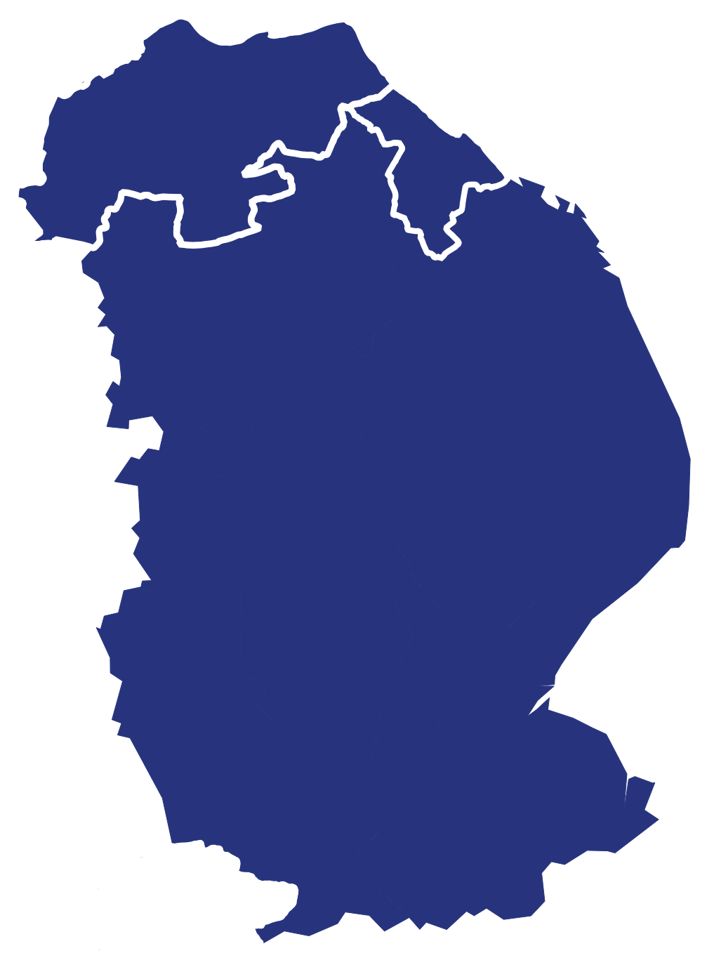
49
LEVEL 3 EMPLOYER DEMAND – GREATER LINCOLNSHIRE
Vacancies requiring a minimum education at Level 3 over time
Level 3 minimum education vacancies as a proportion of all vacancies requiring a qualification
Minimum education at Level 3 vacancy growth index, 2013=100
Growth in all vacancies stating a qualification requirement, 2013=100
Whilst Greater Lincolnshire has a higher proportion of its workplace population qualified to Level 3, trends in vacancies stating a minimum Level 3 qualification have broadly been in line with national changes i.e., positive growth in numbers, and as a proportion of overall vacancies requiring a qualification. However, more recent growth in vacancies requiring a Level 3 qualification has been higher than that seen nationally.

Slide 50
50
LEVEL 3 EMPLOYER DEMAND – GREATER LINCOLNSHIRE
Occupations of top 10 vacancies requiring a minimum education at Level 3, 2023 (shown as a proportion of all vacancies stating a minimum education at Level 3)
Job titles of top 10 vacancies requiring a minimum education at Level 3, 2023 (shown as a proportion of all vacancies stating a minimum education at Level 3)
Vehicle technicians and care / social workers feature strongly in terms of the top ten vacancies in 2023 requiring a minimum Level 3 qualifications across occupations and job titles. Alongside these there is also sizeable demand for engineers, teaching professions and electricians.

Slide 51
51
LEVEL 3 EMPLOYER DEMAND – LINCOLNSHIRE
Vacancies requiring a minimum education at Level 3 over time
Level 3 minimum education vacancies as a proportion of all vacancies requiring a qualification
Minimum education at Level 3 vacancy growth index, 2013=100
Growth in all vacancies stating a qualification requirement, 2013=100
Similar to Greater Lincolnshire, trends in Lincolnshire vacancies stating a minimum Level 3 qualification have been broadly in line with national changes i.e., positive growth in numbers, and as a proportion of overall vacancies requiring a qualification. However, where Greater Lincolnshire has recently experienced above national growth in Level 3 vacancies, Lincolnshire has continued to mirror national trends.

Slide 52
52
LEVEL 3 EMPLOYER DEMAND – LINCOLNSHIRE
Occupations of top 10 vacancies requiring a minimum education at Level 3, 2023 (shown as a proportion of all vacancies stating a minimum education at Level 3)
Job titles of top 10 vacancies requiring a minimum education at Level 3, 2023 (shown as a proportion of all vacancies stating a minimum education at Level 3)
Care / social workers and teaching professions feature strongly in terms of the top ten vacancies in 2023 requiring a minimum Level 3 qualifications across occupations and job titles. Alongside these there is also sizeable demand for engineers, vehicle technicians and electricians.

Slide 53
53
LEVEL 3 EMPLOYER DEMAND – NORTH EAST LINCOLNSHIRE
Vacancies requiring a minimum education at Level 3 over time
Level 3 minimum education vacancies as a proportion of all vacancies requiring a qualification
Minimum education at Level 3 vacancy growth index, 2013=100
Growth in all vacancies stating a qualification requirement, 2013=100
More recent growth in Level 3 vacancies has been much higher than nationally, though this is broadly in line with overall vacancy growth in the area which has been, and is currently significantly above, the national rate.

Slide 54
54
LEVEL 3 EMPLOYER DEMAND – NORTH EAST LINCOLNSHIRE
Occupations of top 10 vacancies requiring a minimum education at Level 3, 2023 (shown as a proportion of all vacancies stating a minimum education at Level 3)
Job titles of top 10 vacancies requiring a minimum education at Level 3, 2023 (shown as a proportion of all vacancies stating a minimum education at Level 3)
Vehicle technicians and mechanics feature strongly in terms of demand for across Level 3 vacancies with a particular focus on HGV vehicles. Multiple engineering roles, teaching roles and care roles also feature in these top tens though North East Lincolnshire does appear to lean towards the more technical / labour intensive roles than elsewhere in Greater Lincolnshire.

Slide 55
55
LEVEL 3 EMPLOYER DEMAND – NORTH LINCOLNSHIRE
Vacancies requiring a minimum education at Level 3 over time
Level 3 minimum education vacancies as a proportion of all vacancies requiring a qualification
Minimum education at Level 3 vacancy growth index, 2013=100
Growth in all vacancies stating a qualification requirement, 2013=100
Growth in Level 3 vacancies in North Lincolnshire has been above the national rate for the entire period of 2013 to 2023, with the gap in performance widening significantly in recent years. At the same time growth in overall vacancies has been slightly above the national rate for most of this period but has again increased significantly in the last couple of years.

Slide 56
56
LEVEL 3 EMPLOYER DEMAND – NORTH LINCOLNSHIRE
Occupations of top 10 vacancies requiring a minimum education at Level 3, 2023 (shown as a proportion of all vacancies stating a minimum education at Level 3)
Job titles of top 10 vacancies requiring a minimum education at Level 3, 2023 (shown as a proportion of all vacancies stating a minimum education at Level 3)
Whilst vehicle technicians and care workers again dominate the job roles in demand at Level 3, North Lincolnshire does have more varied top ten lists than both Lincolnshire and North East Lincolnshire with demand for nursing roles, plant and machine operatives, construction roles, and pharmacy technicians.

Slide 57
57
FUTURE LEVEL 3 EMPLOYER DEMAND
The number of jobs requiring a Level 3 qualification or above across Greater Lincolnshire is projected to increase by around 62,000 jobs between 2023 and 2035. Of these 62,000 jobs, around 6,000 new jobs will require a Level 3 qualification. Over the same period, jobs requiring a Level 2 qualification or below are set to decrease by approximately 48,000.
It is not just new Level 3 jobs that will need filling as people leaving the workforce will also create numerous job openings that will require a Level 3 qualification. So, over the period 2023 to 2035, just over 41,000 job openings at Level 3 will need filling due to people leaving the workforce mainly due to retirement.
In total, Greater Lincolnshire will have approximately 47,000 Level 3 job opportunities that will need filling between now and 2035. This equates to approximately 23 per cent of all the job opportunities across Greater Lincolnshire that will become available over the next 12 years.
Source: Codename Consulting estimates based on Lightcast projections and Department for Education Labour Market and Skills Projections: 2020 to 2035
Growth and openings in Level 3 jobs across Greater Lincolnshire, 2023 - 2035
North Lincolnshire
Level 3 Job Growth – 400
Level 3 Job Openings – 3,000
Total Level 3 Opportunities – 3,400
North East Lincolnshire
Level 3 Job Growth – 600
Level 3 Job Openings – 3,800
Total Level 3 Opportunities – 4,400
Lincolnshire
Level 3 Job Growth – 400
Level 3 Job Openings – 2,500
Total Level 3 Opportunities – 2,900

